Slide 1
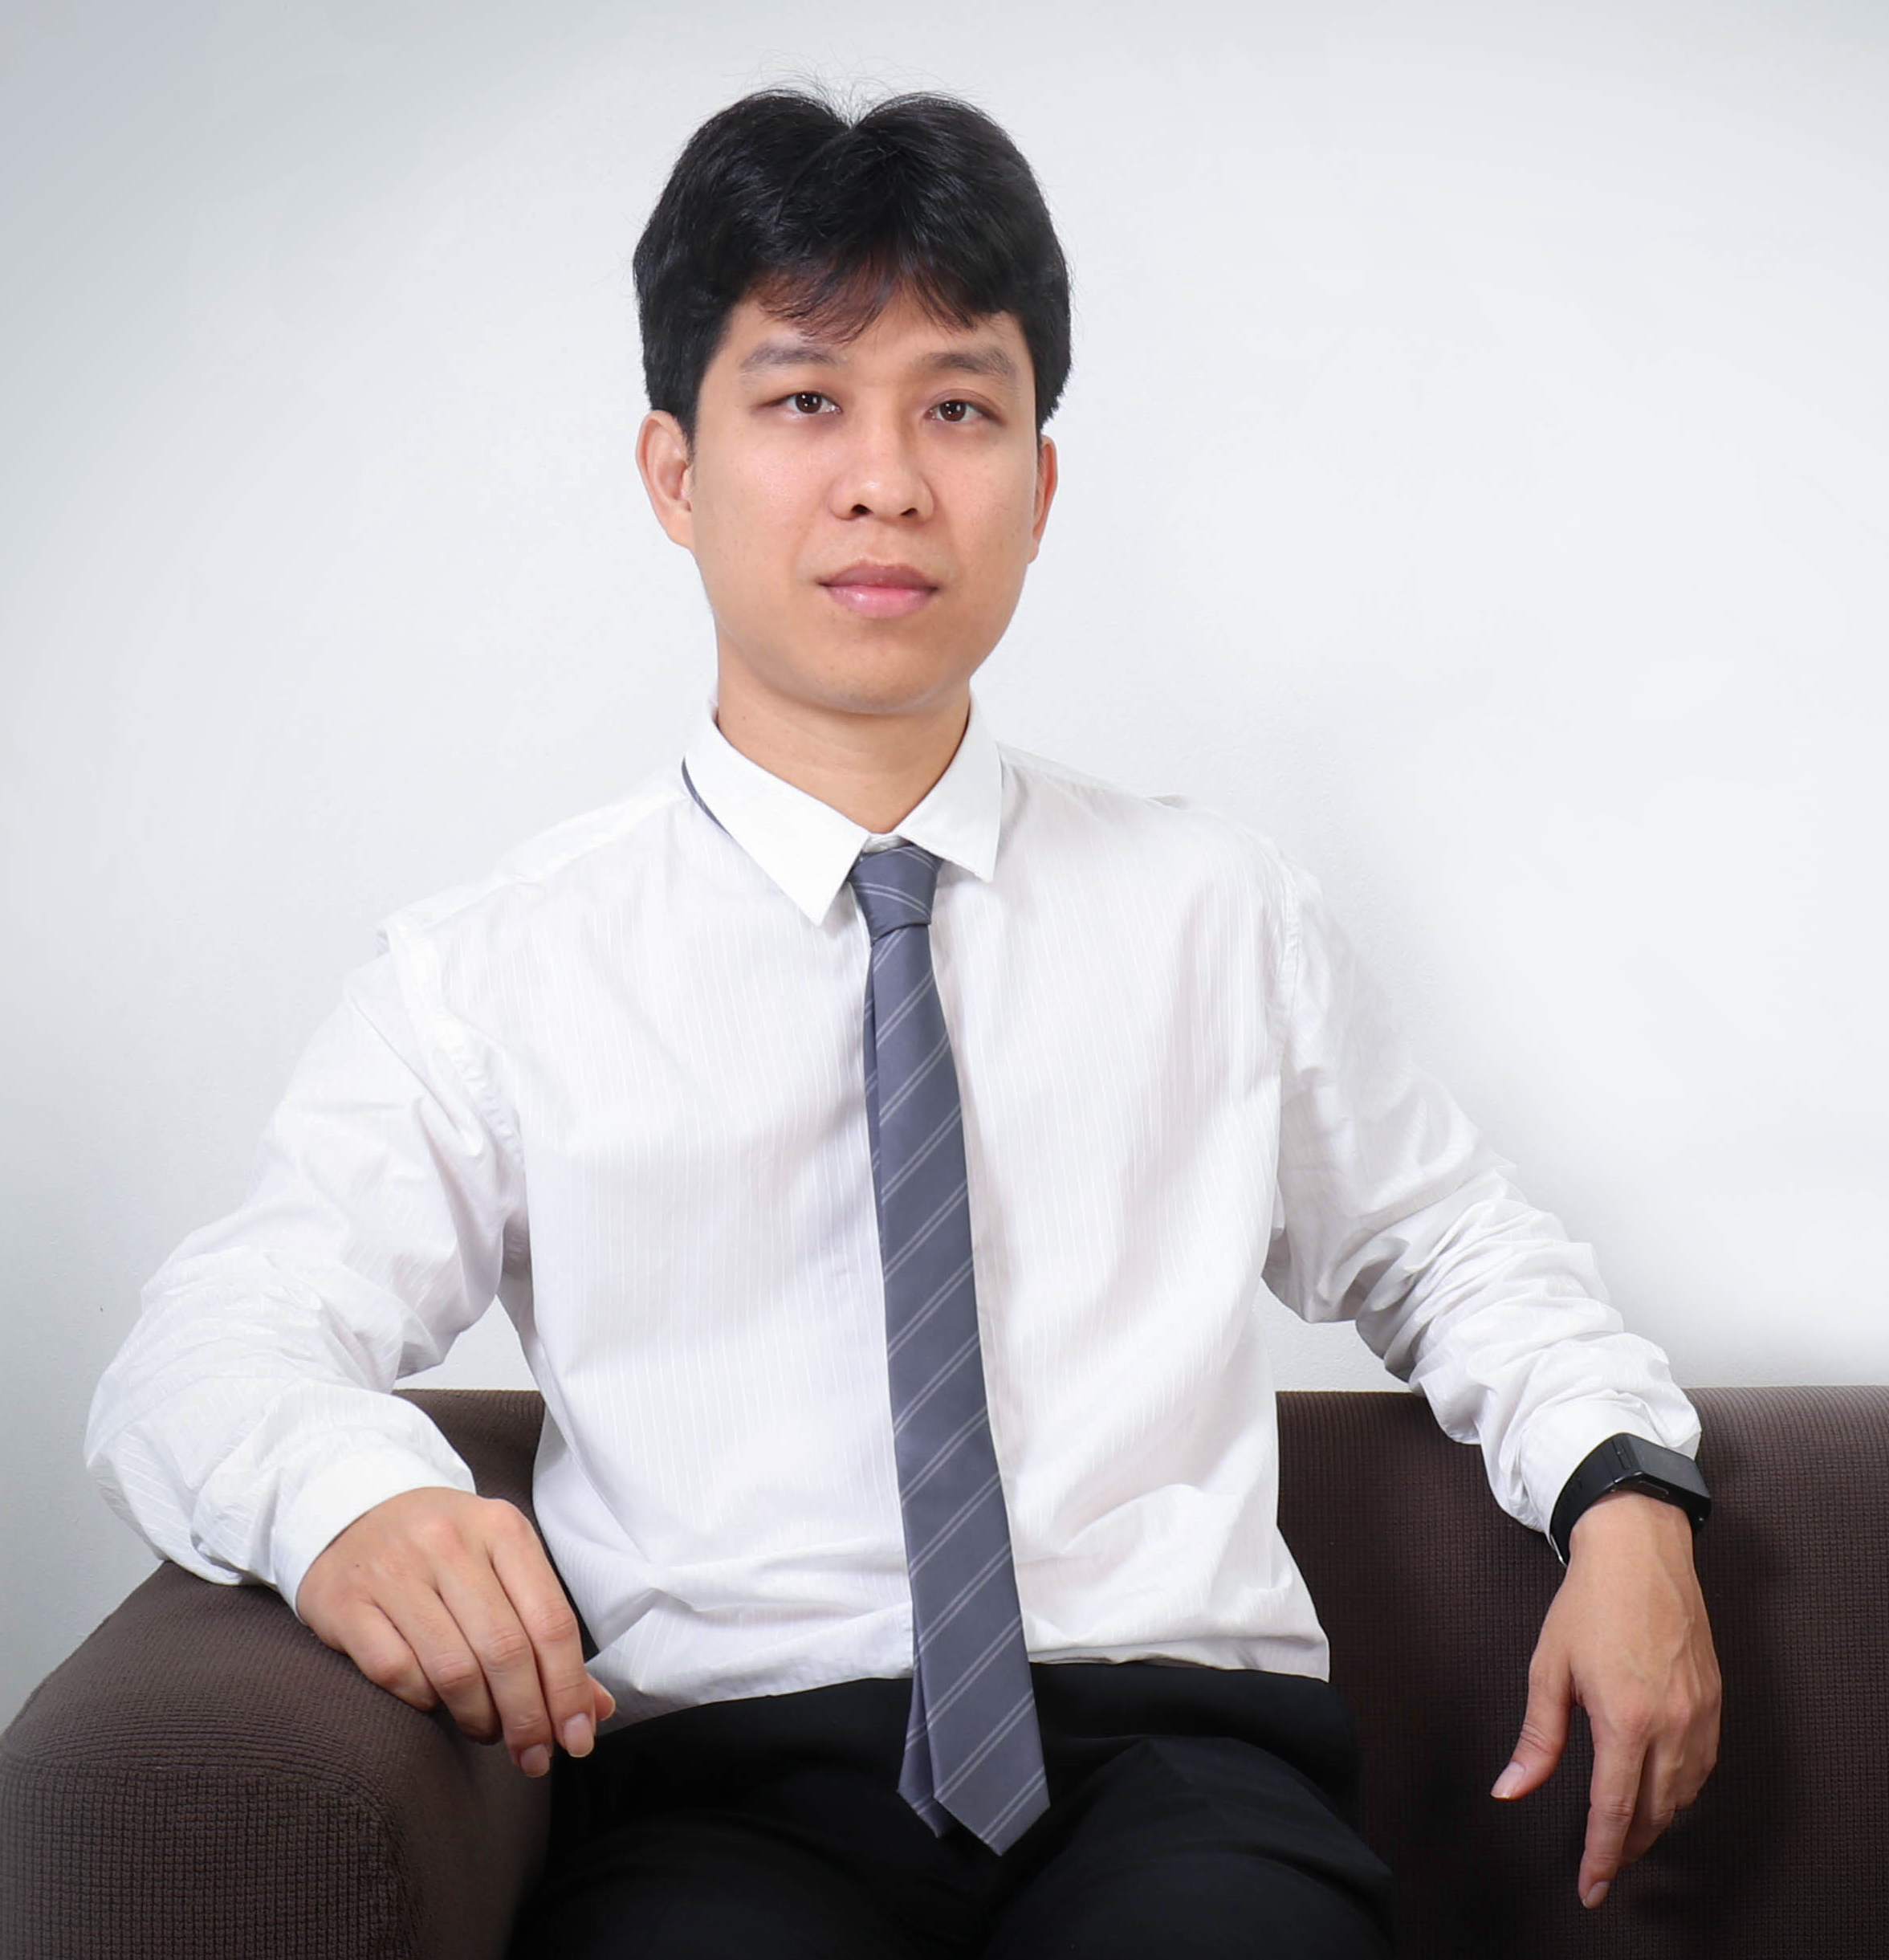
Asst Prof. Warodom Werapun, Ph.D.
warodom.w@psu.ac.th
Research Domain:
Network architectures, Peer-to-Peer, Software defined networks, IoTs, Software engineering
Research projects:
Smart logistics (funded by TRF, Thailand)
Smart appliance control and service delivery (funded by PSU, Phuket)
Scalable Video Coding over Software defined networks (funded by Engineering faculty)
Languages: Thai (Native), English, French, Chinese
Interested technologies
Nodejs, ReactJS,
Android, Kotlin, Docker
https://werapun.com/

