Slide 1
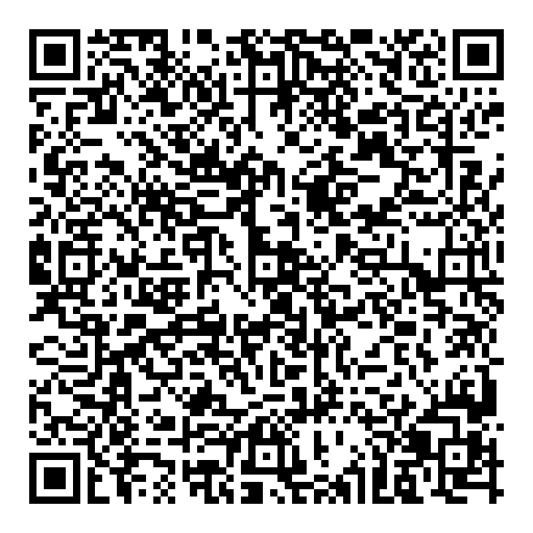
Sample 7
Nattapong Tongtep, PhD
Information Extraction
Text Mining
Human Language Technology
Text Readability Assessment
Pattern Extraction of Polite Response to Customer Feedback
Management Information System for Universal Design in Thailand
Preparing Young Citizen for a Digital Society through Active Learning
Email: nattapong.t@phuket.psu.ac.th

