Slide 1
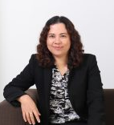
Kanjana Thongglin, Ph.D.
Research Interest:
Natural Language Processing
Controlled Language
Word Sense Disambiguation
Ambiguity in Software Requirements Specification
Artificial Intelligence
Email : kanjana.t@phuket.psu.ac.th
Online Travel Forums Mining Model using Association Rule.
Product Requirements Classification Model using SVM.
Thai software requirements specification pattern.
Semantic level design of Thai software requirements specification using XML as a resource.

