Slide 1
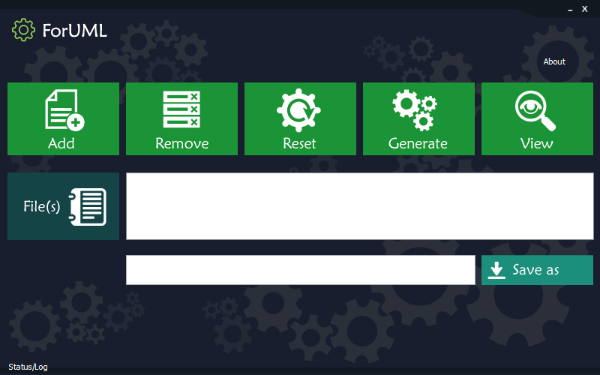
Aziz Nanthaamornphong, Ph.D
Assistant Professor in Computer Science
Research Interests:
Software Engineering
Software Quality
Software Development Tools
Agile software development
Tech Startup in Software Tech Startup
Empirical Software Engineering
Human-aspect in Software Engineering
Ongoing Research Projects:
ForUML – Extraction the UML diagrams from Modern FORTRAN.
Nanthaamornphong, A., Carver, J., Morris, K., & Filippone, S. (2015). Extracting uml class diagrams from object-oriented fortran: Foruml. Scientific Programming, 2015
Nanthaamornphong, A., & Leatongkam, A. (2017). Modern Fortran Transformation Rules for UML Sequence Diagrams. Journal of Telecommunication, Electronic and Computer Engineering (JTEC), 9(3-4), 131-136.

Slide 2
Squirrel – The code snippet repository system
Nanthaamornphong, A., Pomwong, S., Klebkaew, K., & Jindamanee, N. (2017). Squirrel: A Code Snippet Repository. Journal of Telecommunication, Electronic and Computer Engineering (JTEC), 9(3-3), 73-77.
OSS Analytic – Analyze the code smell in OSS projects
Nanthaamornphong, A., & Chaisutanon, A. (2016, September). Empirical evaluation of code smells in open source projects: preliminary results. In Proceedings of the 1st International Workshop on Software Refactoring (pp. 5-8). ACM.
ZSmell – The code smell detection tool integrated with GitHub
More Information:

