Slide 1
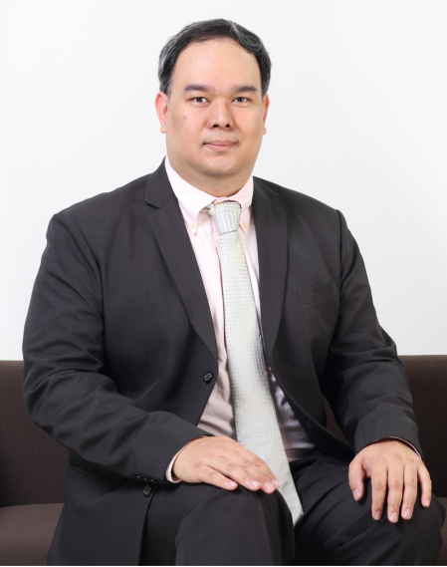
Wasimon
PANICHPATTANAKUL, Ph.D
Contact: wasimon.pa@phuket.psu.ac.th
Research Interest
Software Define Networks
Ad Hoc Networks
Telecommunications
IoTs
Previous Works
Cooperative Networks
Power Control in Telecommunication Systems
Medical Image Processing

