Slide 1
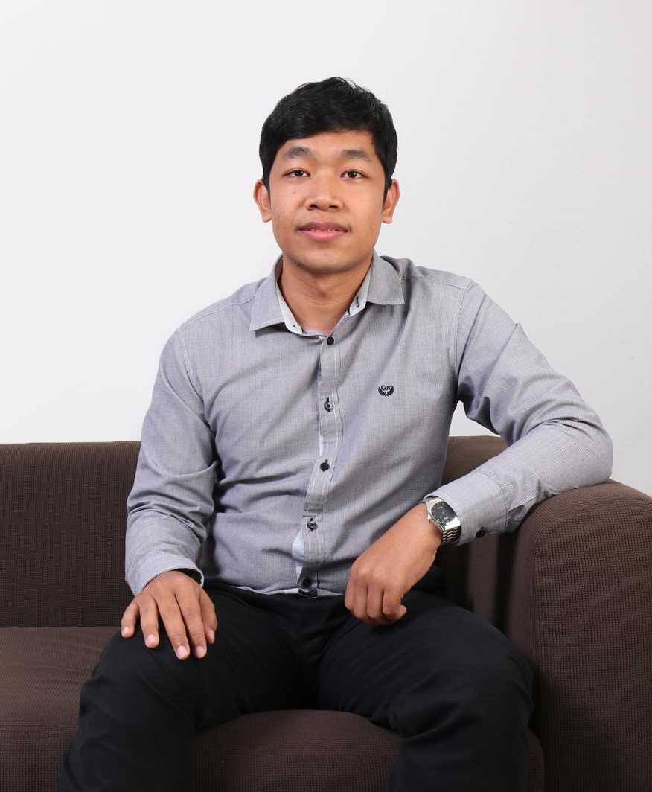
Thitinan Kliangsuwan, Ph.D.
Thitinan.kl@phuket.psu.ac.th
Research Interests:
Image Processing
Pattern Recognition
Machine Learning
Previous work :
Automatic Cloud Classification
Local Cloud Monitoring System

