Slide 1

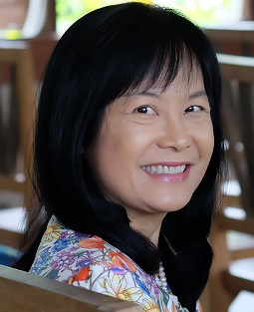


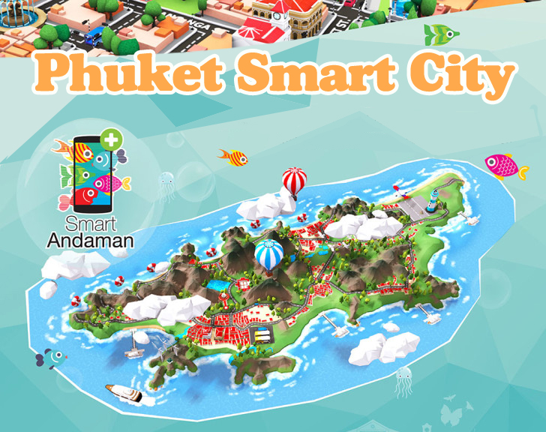

Rattana WETPRASIT, Ph.D.
Assistant Professor in Computer Science
Research Interests
Software engineering practices for project management
Software quality assurance, standards
Policy research in Software Startup Business, City Development, Smart Growth
Ongoing Research Projects
Tech startup situation in Thailand
Smart city
20 Years strategic plan for Andaman (South west) coast of Thailand
For full CV

