Slide 1
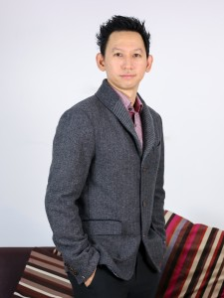

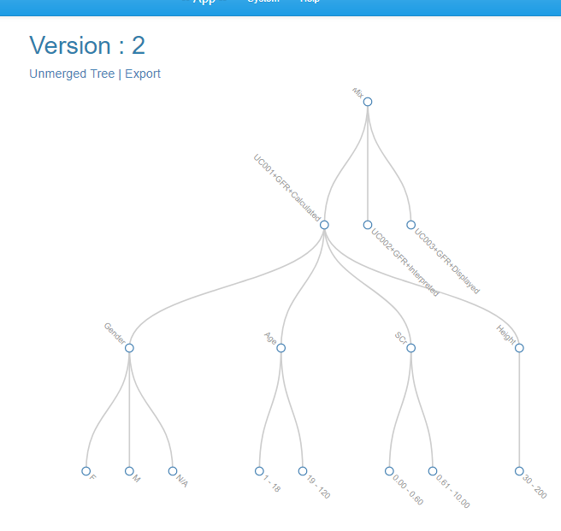
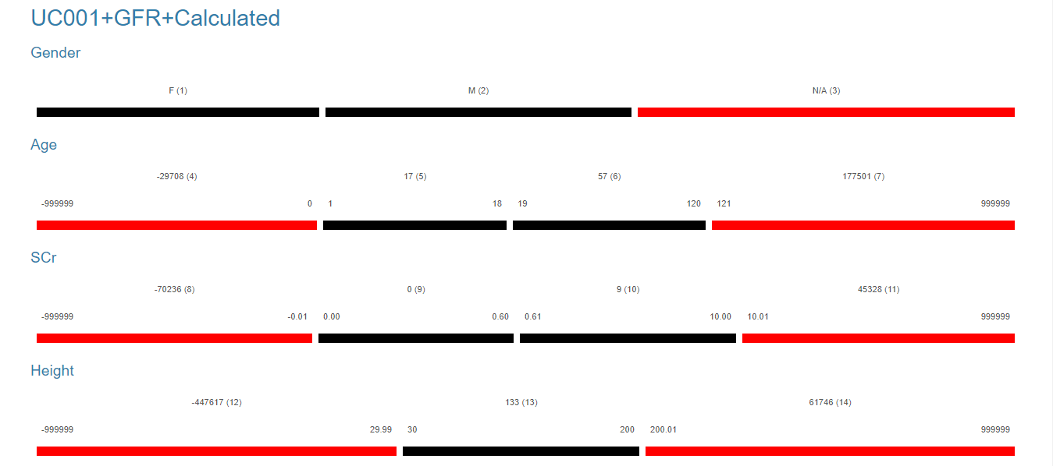
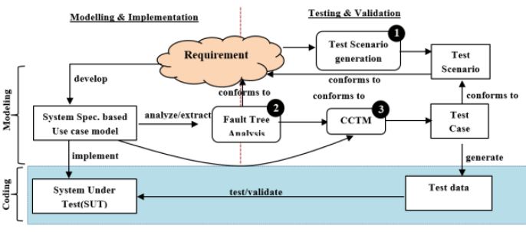
Adisak Intana, PhD
COLLEGE OF COMPUTING
PRINCE OF SONGKLA UNIVERSITY, PHUKET CAMPUS
Research Interests:
Software Engineering
Formal Methods and Engineering
Software Verification and Validation
Software Testing
CASE Tool Development
Ontology Modelling and Engineering
Semantic Web Application
An Impact Analysis Framework of Test Cases Based on Changes of Use Case Based Requirement Specification with the Hybrid Testing Generation Approach of Equivalence Class Partitioning with Classification Tree Method
Ongoing Research Projects:
FATCG (Fault Analysis based Test Case Generation)
Sriraksa, T., Intana, A. (2017) Adding Effectiveness to Combination of Equivalence Partitioning and Classification Tree Based Testing Technique with Fault Tree Analysis. In, the 21st International Computer Science and Engineering Conference 2017, pp.348-353.

Slide 2
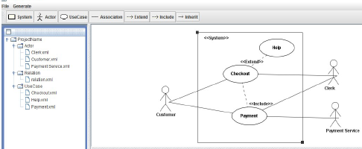
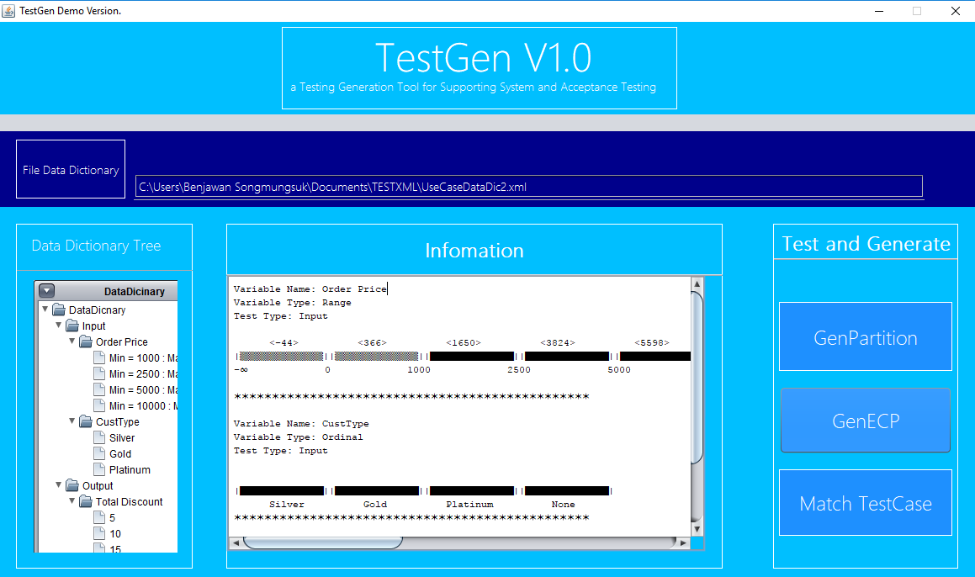
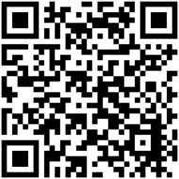
COLLEGE OF COMPUTING
PRINCE OF SONGKLA UNIVERSITY, PHUKET CAMPUS
UCDev (Use Case Development) Tool
Intana, A., Buranapraphan, P., Pitukdansakul, J. and Vongna, S. (2017) A Prototype of Use Case Development for Supporting Scenario Based Requirement Engineering . In, the 9th National Conference on Information Technology (NCIT) 2017, pp.269-274.
TestGen (Test Case Generation) Tool
Intana, A., Sriraksa, T., Kaewyao, S., Phetrupan, J and Singsom, K. (2017) The Prototype Development of Automatic Test Case Generation for Supporting System and User Acceptance Testing . In, the 9th National Conference on Information Technology (NCIT) 2017, pp.246-252.
A Framework of Test Case Generation with Software Requirements Ontology
A Framework of Context – Aware Recommender System for Sport Tourists
More Information:
Email: adisak.i@phuket.psu.ac.th

