Slide 1
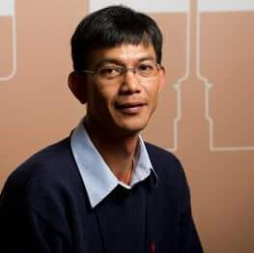
Thammaratt Samitalampa
Research Interests:
+ Data Collection
+ Java Security Model
+ SQL improvement
thammarat.s@phuket.psu.ac.th

