Slide 1
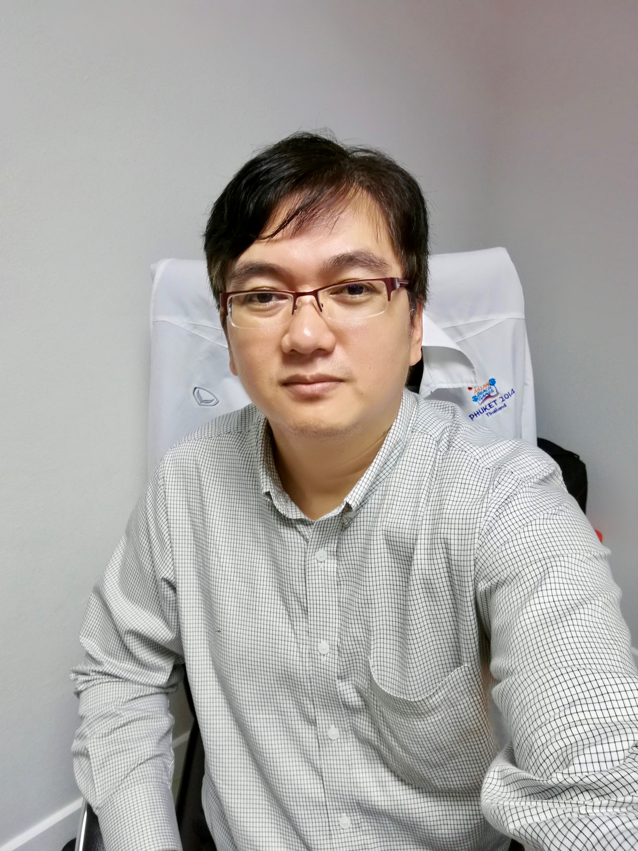
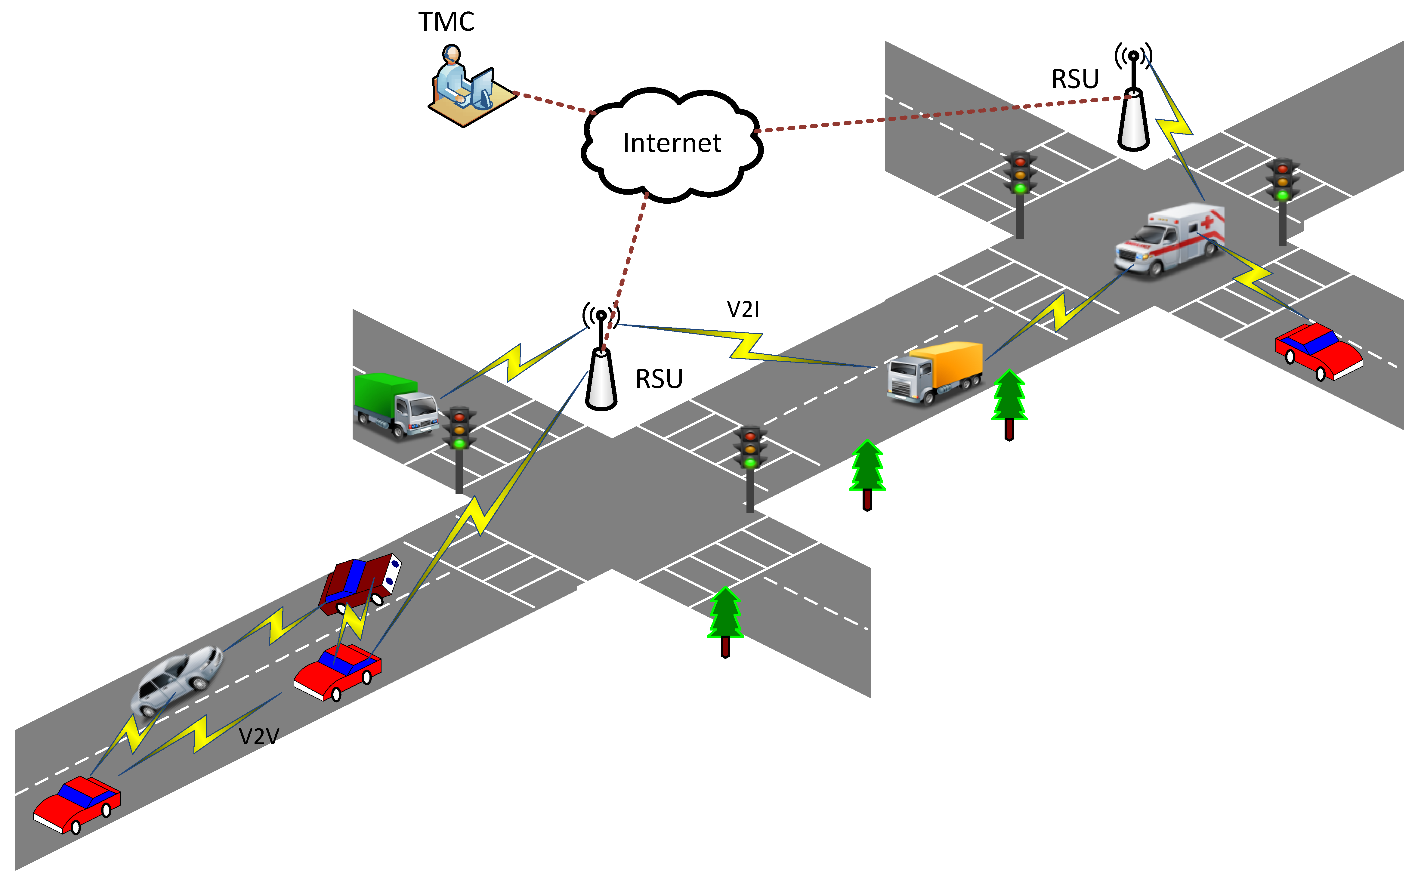
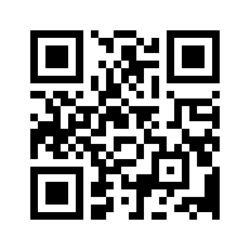
Jirawat Thaenthong, PhD
Research Interests:
Vehicular Networks
Smart Transportations
Smart Health
Internet of Things for Vehicular Networks
Cloud Computing Application for Vehicular Networks
Data Dissemination Models and Security
Email: jirawat.t@phuket.psu.ac.th
Infotainment Data Dissemination Mechanism Using RSU Cloud Based for Vehicular Networks
Cache Replacement Mechanism with Content Popularity for Vehicular Content-Centric Networks
Cloud-based Data Dissemination Mechanism for Vehicular Networks
Efficiency of Packet Delivery Mechanism for Content-Centric Networking in VANET

