Slide 1
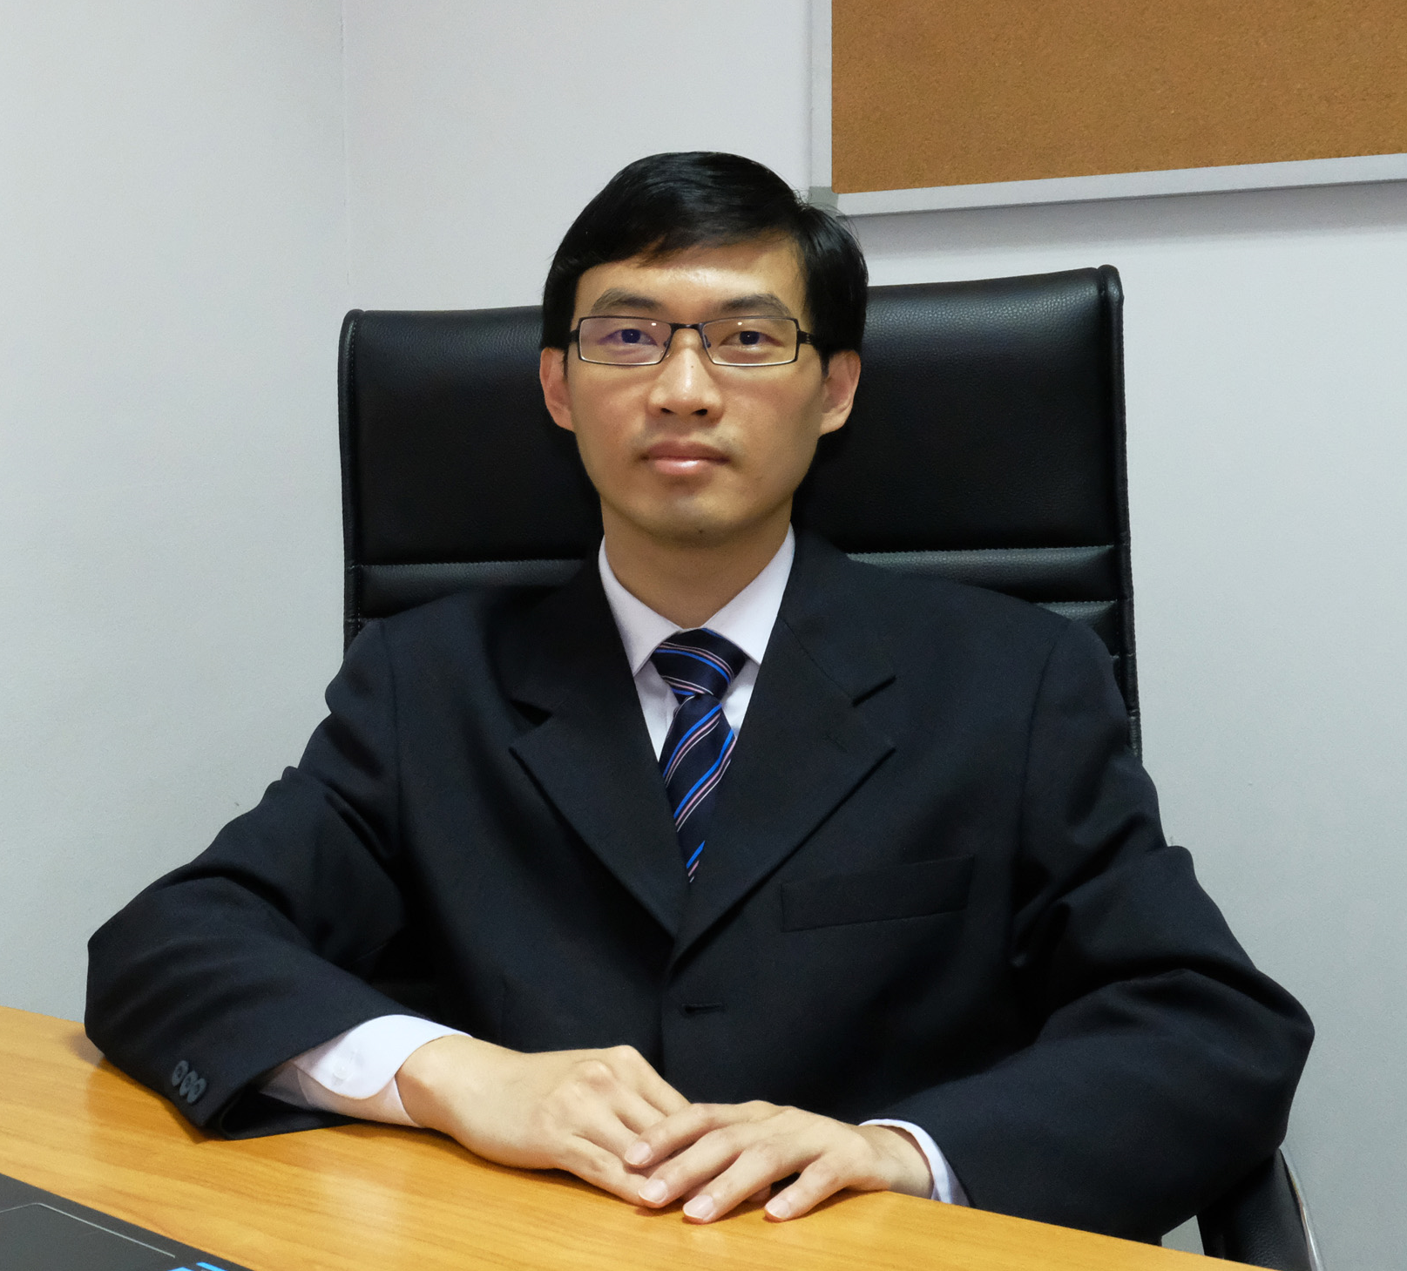
Nawanol Theera-Ampornpunt, Ph.D.
Research Interests:
Computer Vision
Machine Learning
Game-playing AI
Mobile Computing
Research Projects:
Traffic Sign Detection and Classification
Sentiment Analysis of Business Reviews
Email: nawanol.t@phuket.psu.ac.th

