Slide 1
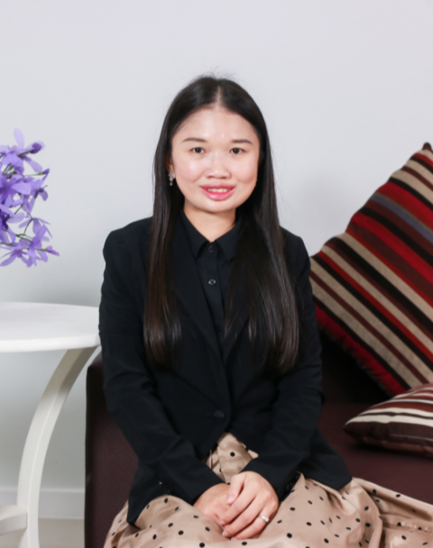
KWANKAMON DITTAKAN, Ph.D
AREA OF INTERESTS
Data Warehousing, Big Data and Data Mining
Image Mining and Image Analysis
RESEARCH PROJECTS
Medical Image Analysis and Mining
Image Processing and Understanding Applications
Signal and Image Mining for Agriculture
Population Estimation Mining From Satellite Imagery
College of Computing, Prince of Songkla University, Phuket Campus
80 Moo 1, Vichitsongkram Road, Kathu, Phuket 83000
Telephone: (+66) 76276712
E-Mail: kwankamon.d@phuket.psu.ac.th

