Slide 1
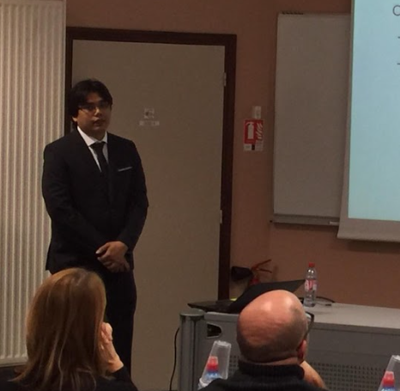
Chakadkit THAENCHAIKUN, Ph.D
Research Interests:
Computer Network
Green Network (Energy-Efficient Ethernet)
Software Defined Network
Traffic Engineering
Segment Routing
Internet Protocol
Ns3 – Network Simulation 3
C. Thaenchaikun, G. Jakllari, and B. Paillassa, Augmenting the energy saving impact of IEEE 802.3az via the control plane, in 2015 IEEE International Conference on Communication Workshop (ICCW 2015), London, UK, June 2015.

Slide 2
ONOS – Open Network Operating System
SDN – Software Defined Network
C. Thaenchaikun, W. Panichpattanakul, “Control-Plane OpenFlow Segment Routing SDN for Network Control Messages Reduction”, in Proc.2017 IEEE International Conference on Electrical Engineering/Electronics, Computer, Telecommunications and Information Technology (ECTI-CON 2017)
C. Thaenchaikun, G. Jakllari, B. Paillassa, W. Panichpattanakul, “Mitigate the Load Sharing of Segment Routing for SDN green Traffic Engineering”, in Proc. 2016 IEEE International Symposium on Intelligent Signal Processing and Communication Systems (ISPAC 2016)
SDN
Software Defined Network
EEE – Energy Efficient Ethernet
B. Paillassa, R. Dhaou, G. Jakllari, and C. Thaenchaikun, Performance evaluation of energy efficient policies for ethernet switches, in Wireless Communications and Mobile Computing Conference (IWCMC 2013), Cagliari, Sardinia, Italy, July 2013

